Slide 1
Reference Sequence:
ATG TCT GGA TAC CCG AAT GTC
ATG TCA GGA TAC CCG AAT GTC
Substitution
ATG TCT TAC CCG AAT GTC
Deletion

Slide 2
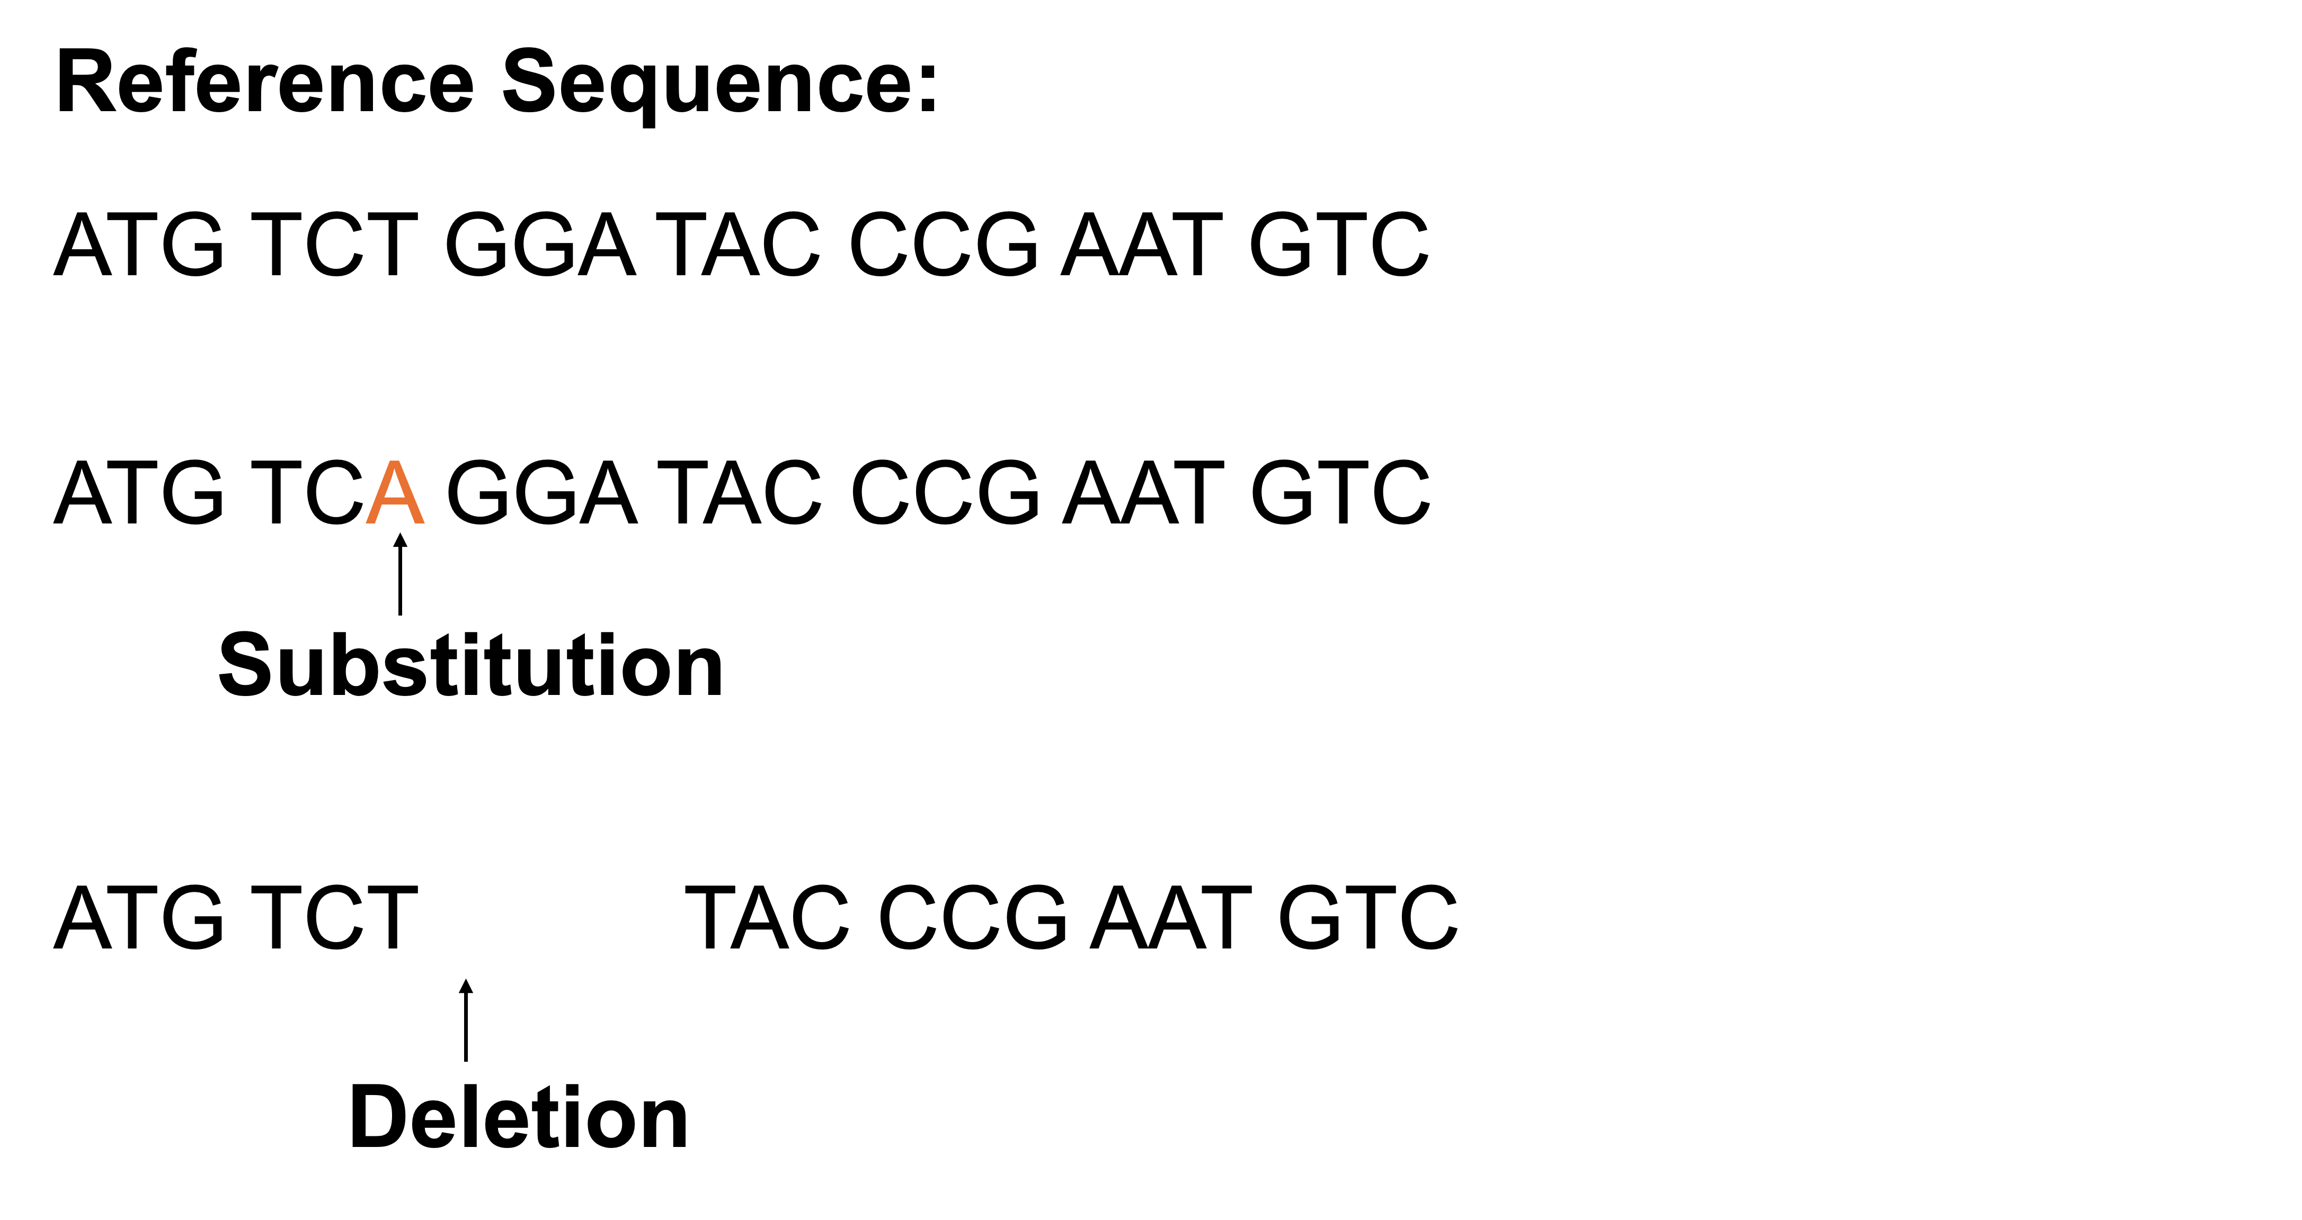
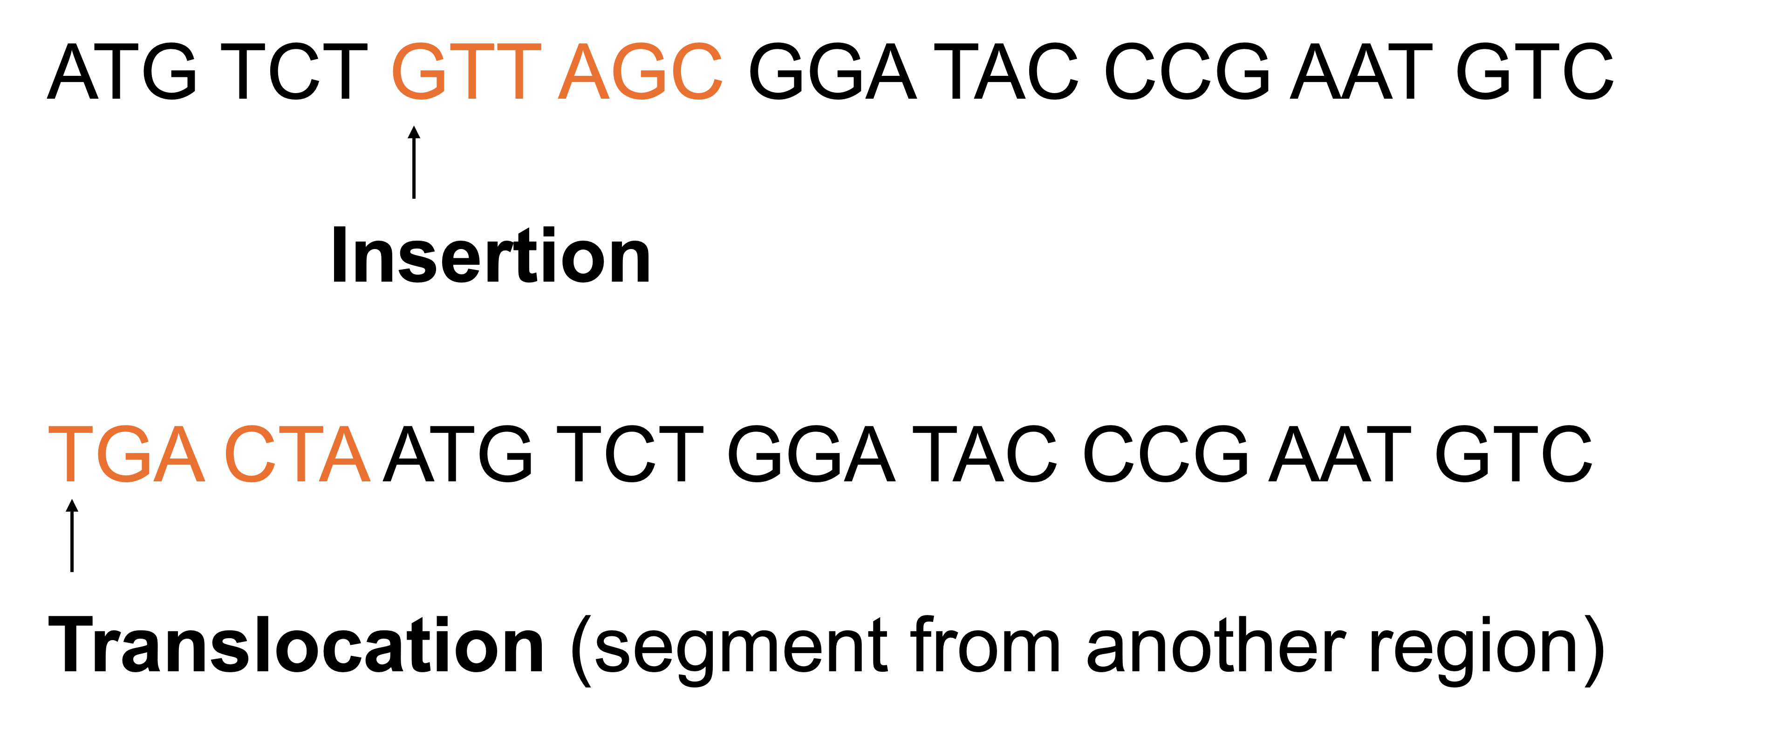

Slide 4
ATG TCT GTT AGC GGA TAC CCG AAT GTC
Insertion
TGA CTA ATG TCT GGA TAC CCG AAT GTC
Translocation (segment from another region)

Slide 5

Individual 1:
Allele A
C T C G T C A C T T C A C
G A G C A G T G A A G T G
C T C A T C A C T T C A C
G A G T A G T G A A G T G
Allele a
The genotype at this SNP: Aa

Slide 6
Individual 2:
Allele a
C T C T T C A C T T C A C
G A G A A G T G A A G T G
C T C A T C A C T T C A C
G A G T A G T G A A G T G
Allele a
The genotype at this SNP: aa

Slide 7
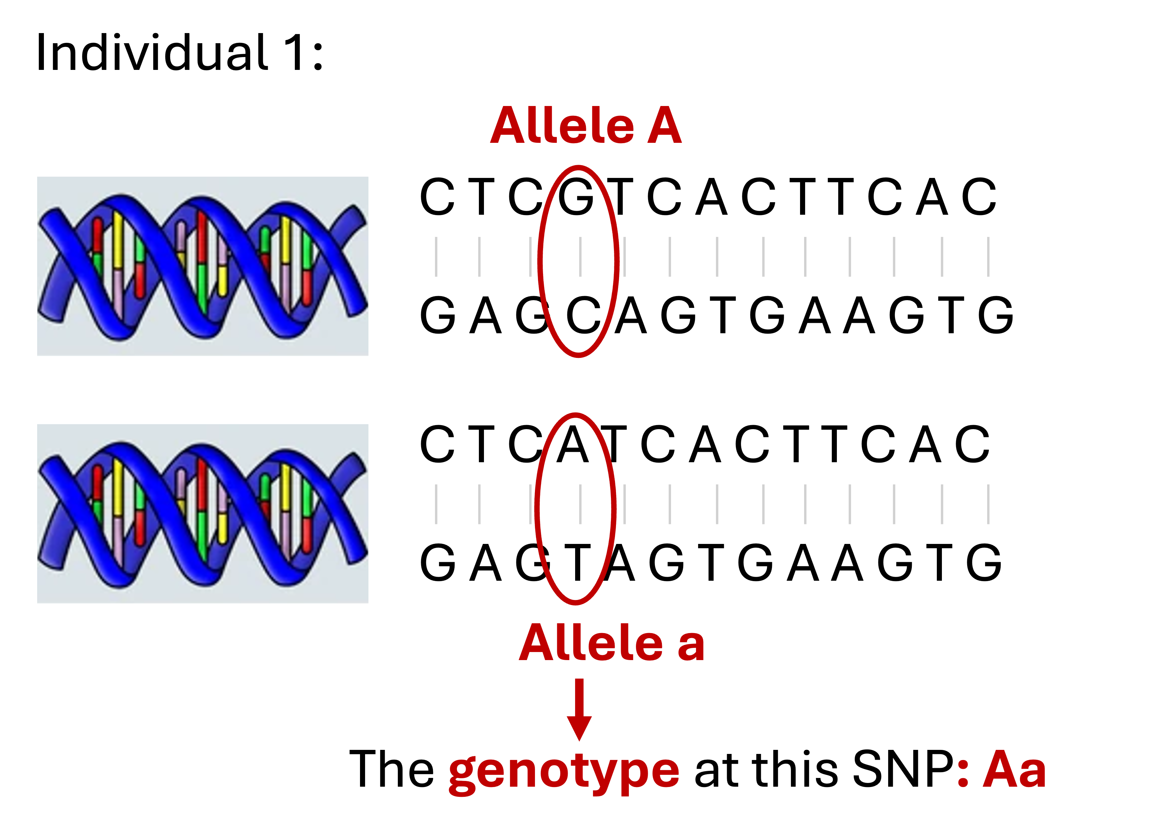


Slide 8
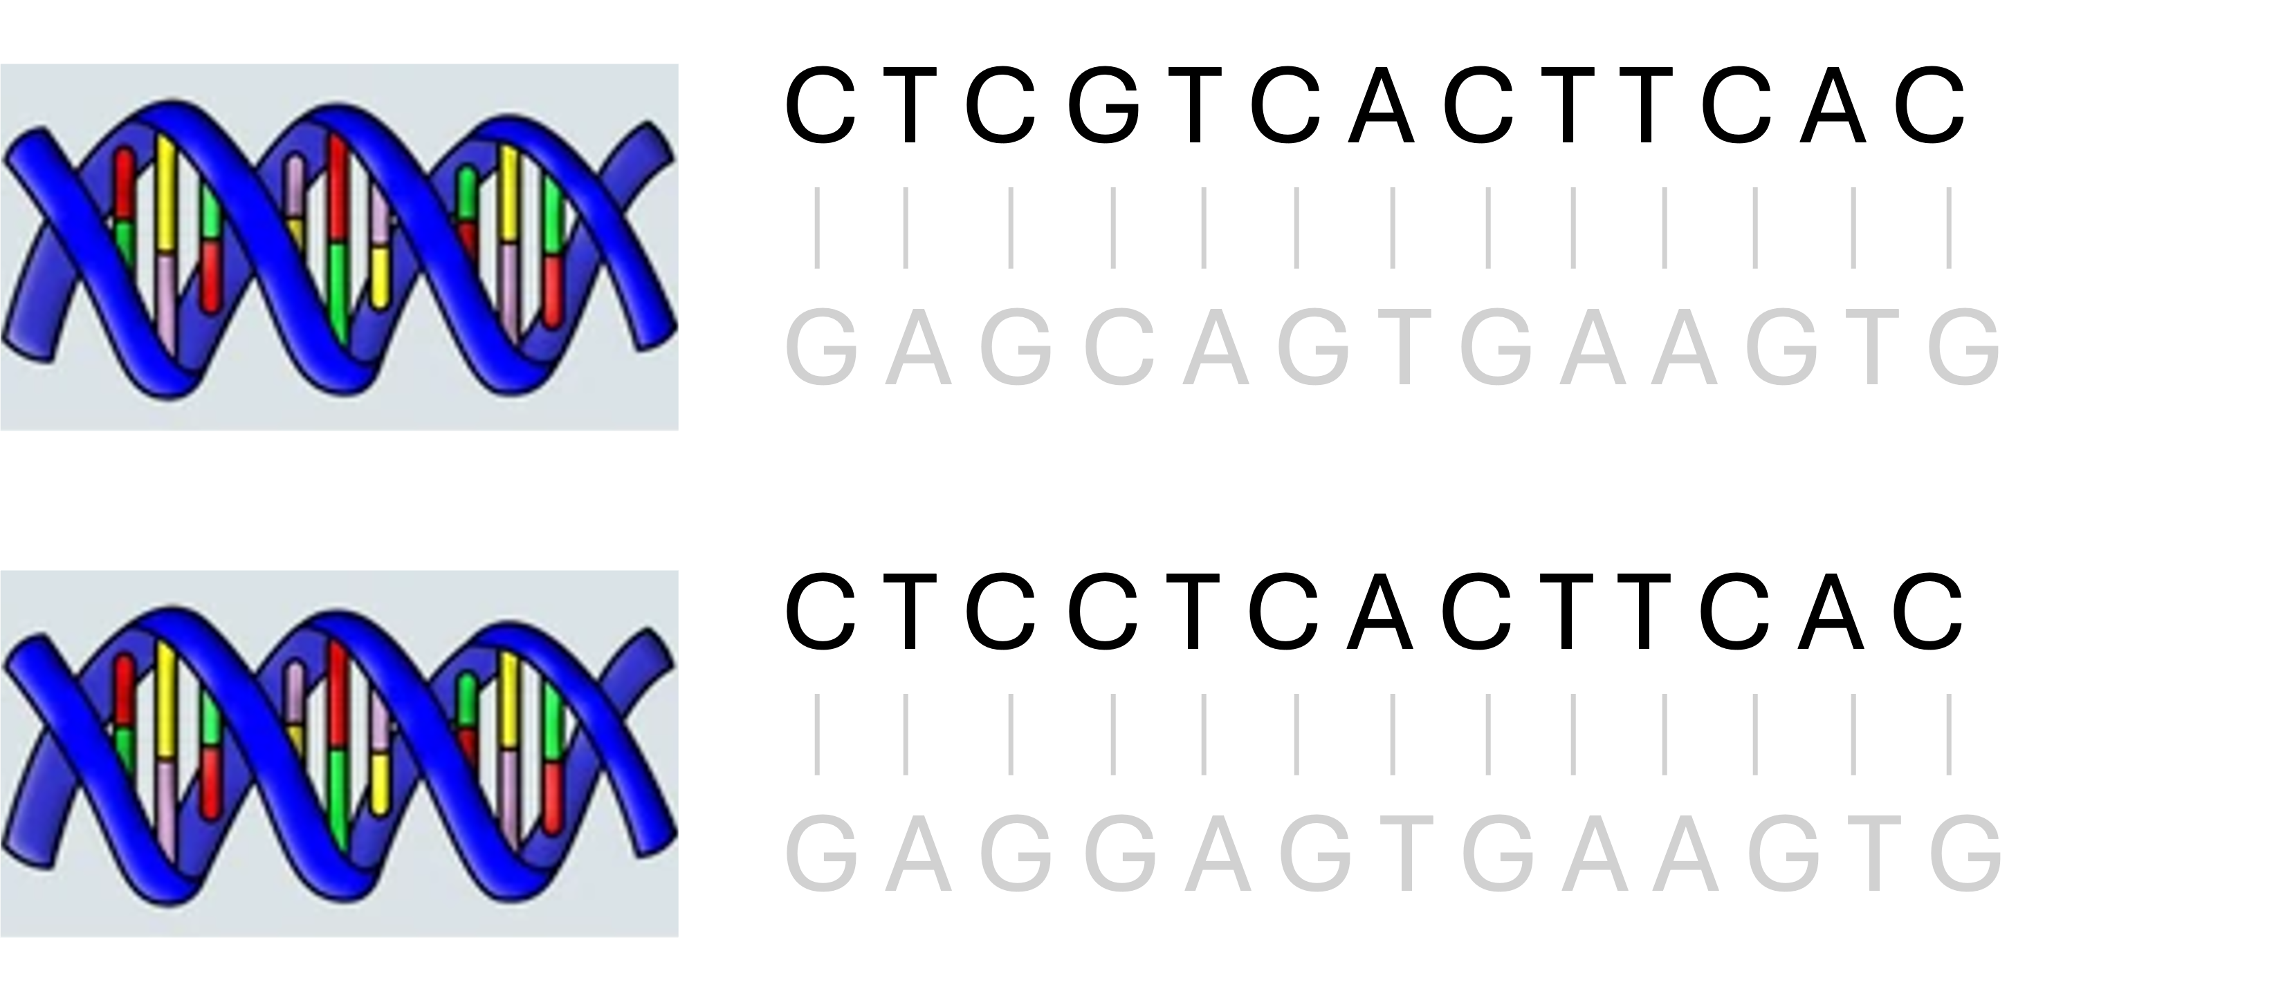
Allele A
Allele a
Genotype: Aa

Slide 9
C T C G T C A C T T C A C

Slide 11
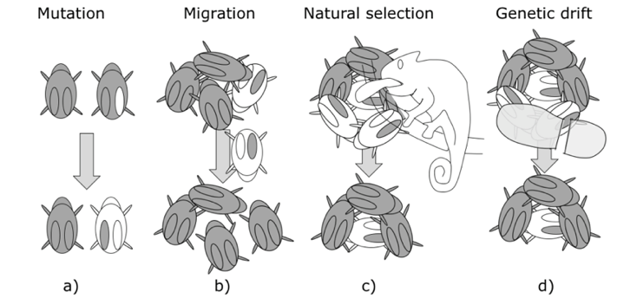
Source: Publicly available from Google Images

Slide 12
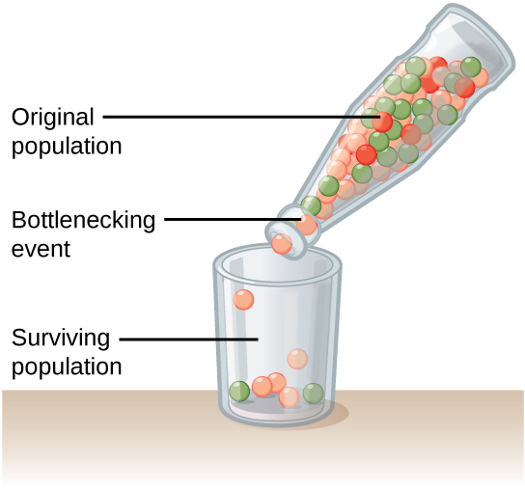
Source: Publicly available from Google Images

Slide 13
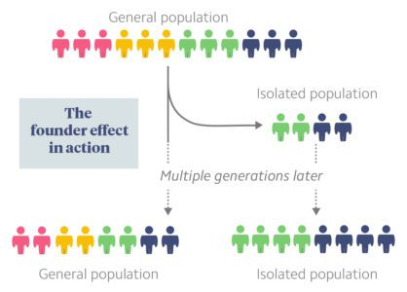
Source: Publicly available from Google Images

Slide 14
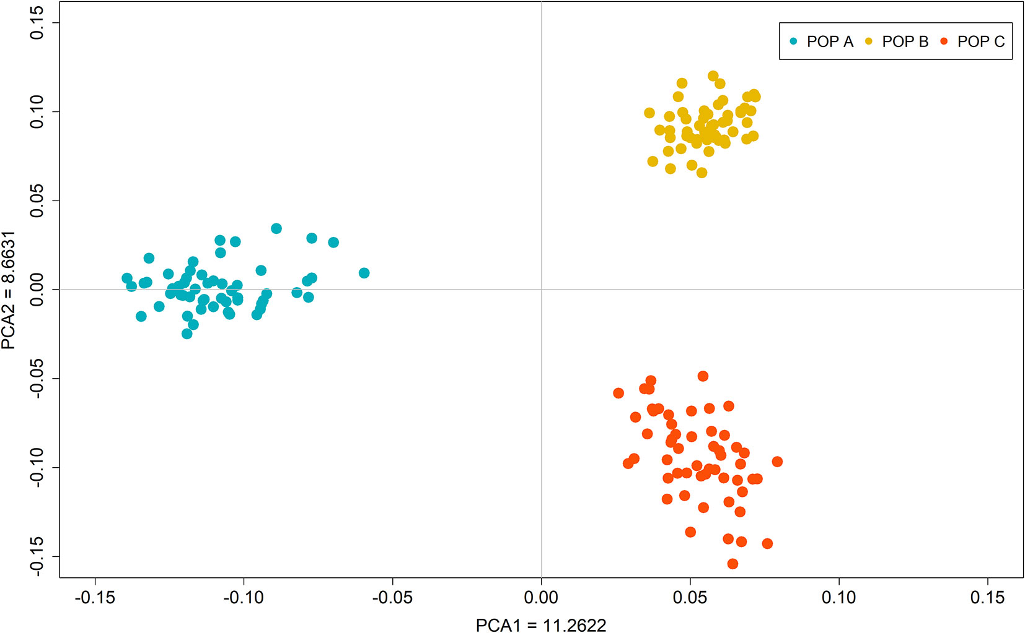
Source: Publicly available from Google Images

Slide 15
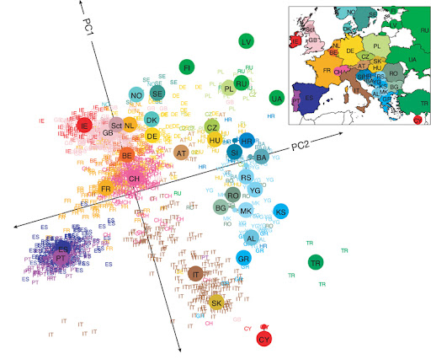
Population Structure in Europe
Source: Publicly available from Google Images

Slide 16
Recessive
X | G
1 | AA
0 | Aa or aa
Dominant
X | G
1 | AA or Aa
0 | aa
Additive
X | G
2 | AA
1 | Aa
0 | aa
Source: Created by Fan Wang

Slide 17
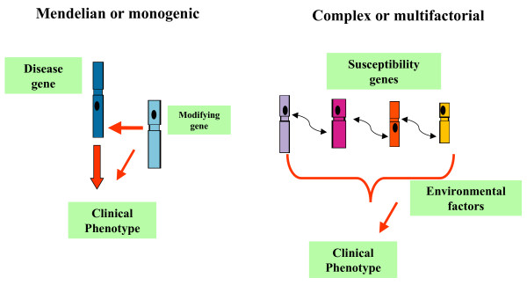
Source: Publicly available from Google Images

Slide 18
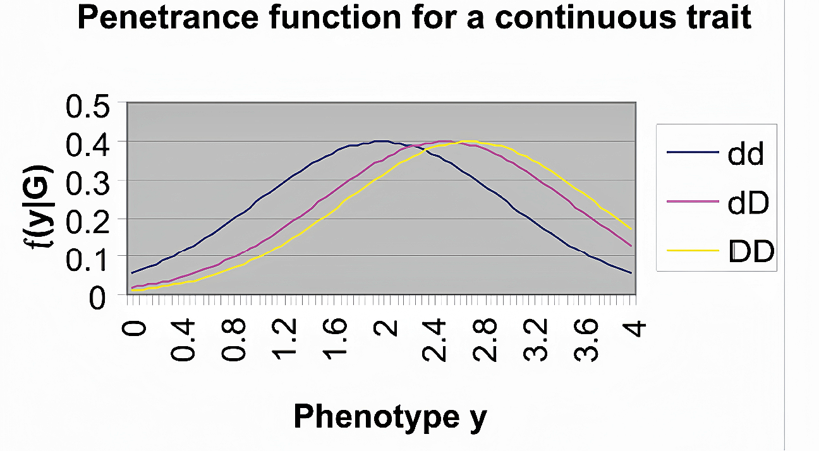
Source: Publicly available from Google Images

